Slide 1

Raw Data Study Parameters
Sex
Age
Op Date
수술 후 재원 기간
Weight
Height
BMI
현재흡연유무
음주유무
Association condition
stomach OP (Ca.외) History
stomach OP(Ca.) History
other Ca. History
Chemo-therapy (Adjuvant)
Clinical stage
WBC
Hemoglobin
Segmented neutrophil
ANC
Lymphocytes
Platelets
OP time
EBL
ASA score
Operation
Reconstruction
R
Cytology
LN Dissection
Combined Resection
Combined op
OP전 CTx.
Intraop. complication
Diagnosis
Location
Histology
Lauren
Size
pT(7th)
pN(7th)
pMeta
fTNM
fStage
Ass. Lesion
NCC last F/U
OP이후 새로운Ca.
타병원 F/U
Recur, meta date
Recur, meta site
Recur Dx
Death
Death Date
Cause of Death
post OP Early Complications (Within 30days)
Early Complication C-D classification
Late Complications
Late Complication C-D classification
Clinical DB
* 빨간색표시는 모델에 사용된 변수를 의미함;

Slide 2
ML Study Parameters
Sex
Age
Op Date
수술 후 재원 기간
Weight
Height
BMI
현재흡연유무
음주유무
Association condition
stomach OP (Ca.외) History
stomach OP(Ca.) History
other Ca. History
Chemo-therapy (Adjuvant)
Clinical stage
WBC
Hemoglobin
Segmented neutrophil
ANC
Lymphocytes
Platelets
OP time
EBL
ASA score
Operation
Reconstruction
R
Cytology
LN Dissection
Combined Resection
Combined op
OP전 CTx.
Intraop. complication
Diagnosis
Location
Histology
Lauren
Size
pT(7th)
pN(7th)
pMeta
fTNM
fStage
Ass. Lesion
NCC last F/U
OP이후 새로운Ca.
타병원 F/U
Recur, meta date
Recur, meta site
Recur Dx
Death
Death Date
Cause of Death
post OP Early Complications (Within 30days)
Early Complication C-D classification
Late Complications
Late Complication C-D classification
Clinical DB
* 빨간색표시는 모델에 사용된 변수를 의미함;

Slide 3
hospital_stay_days | Intraop_cc_bleeding | stm.op.exceptca | Histology_Moderately-diff
ASA_Score_I | Intraop_cc_organ_injury | stm.op.ca | Histology_Mucinous
ASA_Score_II | Intraop_cc_cardia | oth.ca.within1Y | Histology_Other
ASA_Score_III | Intraop_cc_anastomosis_failure | oth.ca | Histology_Papillary
ASA_Score_IV | Intraop_cc_others | Adjuvant | Histology_Poorly-diff
bf.op.CTx | Sex_F | Cytology_Negative | Histology_Signet cell
Size | Sex_M | Cytology_Not_Performed | Histology_Signet cell,Poorly-diff
Reconstruction_BI | Age_group_1 | Cytology_Positive | Histology_Well-diff
Reconstruction_BII | Age_group_2 | Cytology_Suspicous_suggestive | LN_Dissection_nm_1.D1
Reconstruction_DTH | Age_group_3 | Cytology_Unknown | LN_Dissection_nm_2.D2
Reconstruction_Esophago-gastrostomy | Age_group_4 | Clinical_Stage_I | Ass_condition_HT
Reconstruction_Gastro-gastrostomy | Diagnosis_AGC | Clinical_Stage_II | Ass_condition_DM
Reconstruction_Gastro-gastrostomy,Esophago-gastrostomy | Diagnosis_EGC | Clinical_Stage_III | Ass_lesion
Reconstruction_Others | Operation_OPG | Clinical_Stage_IV | Smoking
Reconstruction_Roux-en-Y | Operation_PG | fStage_group_0 | Drinking
Z_EBL | Operation_PPG | fStage_group_I | BMI
Platelets | Operation_STG | fStage_group_II | OP_time
Albumin | Operation_TG | fStage_group_III
Cell_Count | Lauren_Diffuse | fStage_group_IV
WBC | Lauren_Indeterminate | Location_nm_1
Lymphocytes | Lauren_Intestinal | Location_nm_2
Combined_Resection_None | Lauren_Mixed | Location_nm_3
Combined_op_None | Lauren_Unknown | Location_nm_4

Slide 4
Handle with NA value
Continuous Value
Categorical Value
중앙값,평균값으로 대체
(Hospital days
BMI, Tumor Size)
가장 많은 값으로 대체
(Clinical Stage, Lauren, Smoking, Drinking)

Slide 5
Stacking
Stacking procedure는 다음과 같이 2 단계로 진행
Level 0 : training dataset을 이용하여 sub-model 예측 결과를 생성
Level 1 : level 0의 output 결과가 level 1의 input 값이 된다. level 0의 output을 training data로 사용하여 meta learner 모델을 생성
이러한 2 단계 과정을 거치며 stacked generalization(meta learner)은 level 0에서 사용한 training data와 다른 dataset을 사용하기 때문에 overfitting을 방지하고 bias 줄이게 됨

Slide 6

Model Constructure
Random Forest
Extra Trees
AdaBoost
Gradient Boosting
SVC
XGBoost - Stacking Model, 5 Fold cross validation

Slide 7
Feature Importance
features | Random Forest feature importances | Extra Trees feature importances | AdaBoost feature importances | Gradient Boost feature importances | SVM feature importances | mean
hospital_stay_days | 0.423393 | 0.179739 | 0.0475 | 4.46E-01 | 4.43E-01 | 0.30804
BMI | 0.022848 | 0.003324 | 0.155 | 6.03E-02 | 6.30E-02 | 0.06089
OP time | 0.077608 | 0.060153 | 0.0575 | 4.96E-02 | 4.50E-02 | 0.05797
Cell Count | 0.020282 | 0.00439 | 0.16 | 4.95E-02 | 5.24E-02 | 0.05733
WBC | 0.027101 | 0.005601 | 0.14 | 4.81E-02 | 4.65E-02 | 0.05345
Platelets | 0.025544 | 0.004128 | 0.1 | 5.47E-02 | 5.11E-02 | 0.04710
Z_EBL | 0.05807 | 0.02292 | 0.0575 | 2.93E-02 | 2.94E-02 | 0.03944
Lymphocytes | 0.021029 | 0.002977 | 0.09 | 2.55E-02 | 2.97E-02 | 0.03384
Size | 0.018185 | 0.004359 | 0.045 | 2.84E-02 | 2.74E-02 | 0.02467

Slide 8
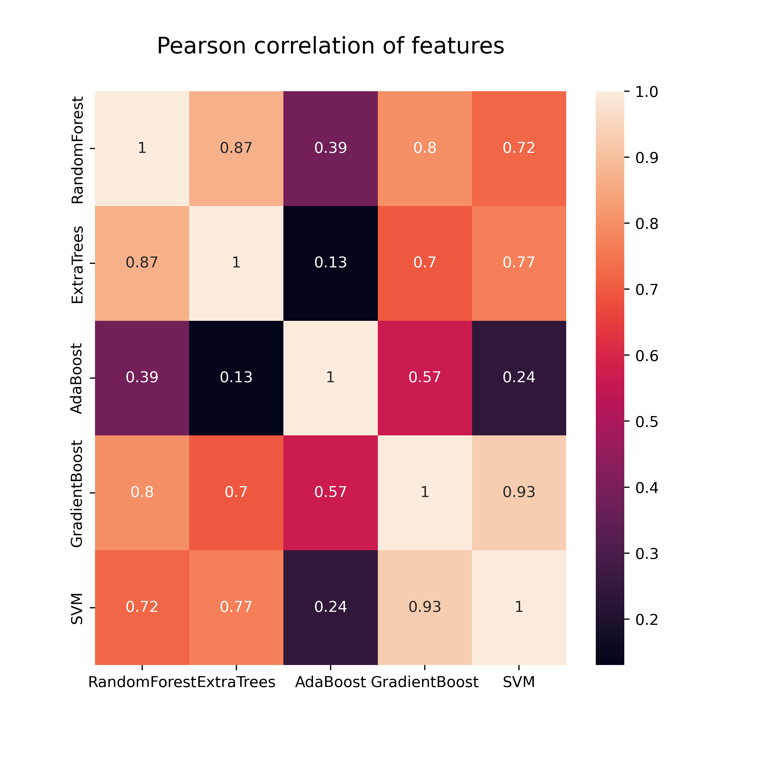
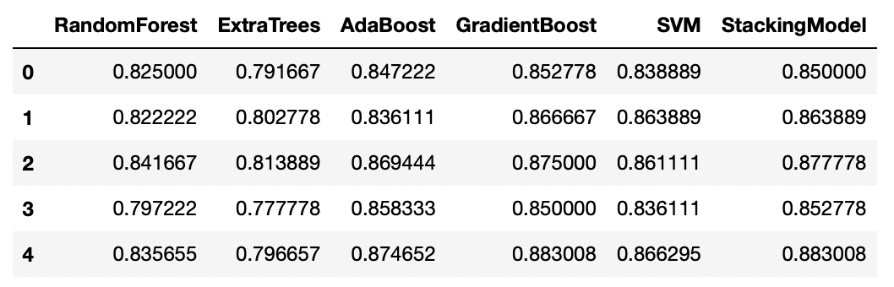
Feature Correlation Comparison

Slide 9
features | Random Forest feature importances | Extra Trees feature importances | AdaBoost feature importances | Gradient Boost feature importances | SVM feature importances | mean
OP_time | 0.131944 | 0.074573 | 0.0725 | 0.123328 | 1.21E-01 | 0.10461
Cell_Count | 0.032314 | 0.005345 | 0.185 | 0.08024 | 8.94E-02 | 0.07847
WBC | 0.04599 | 0.006814 | 0.165 | 0.083539 | 8.15E-02 | 0.07657
BMI | 0.043548 | 0.004638 | 0.115 | 0.092776 | 8.93E-02 | 0.06905
Z_EBL | 0.108889 | 0.022358 | 0.0575 | 0.059615 | 5.84E-02 | 0.06135
Platelets | 0.046297 | 0.006857 | 0.085 | 0.075032 | 7.37E-02 | 0.05738
Lymphocytes | 0.03835 | 0.004547 | 0.1 | 0.05533 | 5.78E-02 | 0.05121
Albumin | 0.053415 | 0.010827 | 0.015 | 0.058857 | 5.67E-02 | 0.03896
Size | 0.032178 | 0.004776 | 0.06 | 0.04384 | 4.54E-02 | 0.03723

Slide 10
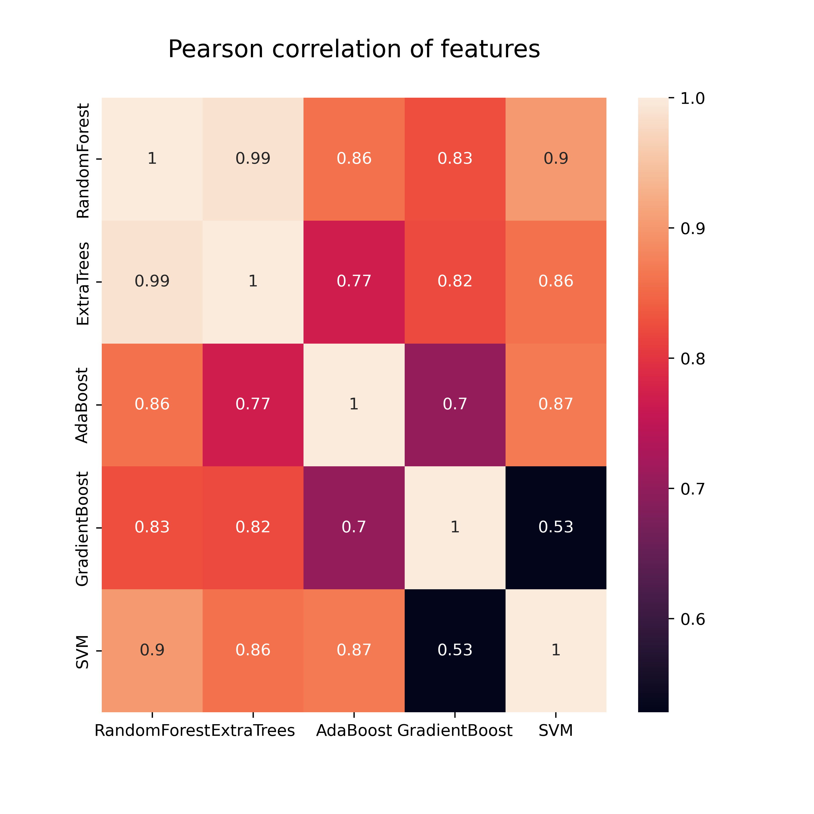
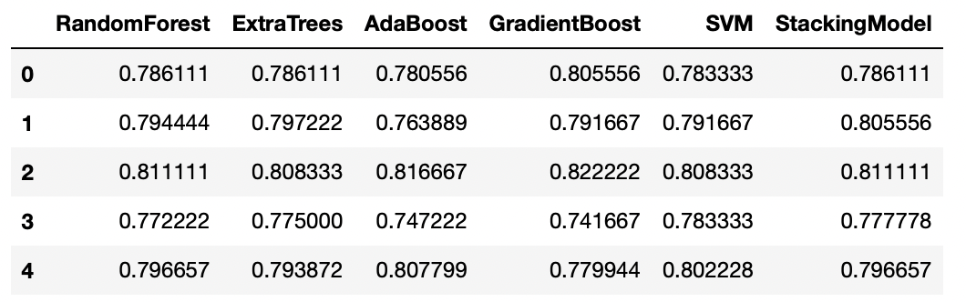
Feature Correlation Comparison

Slide 11
Discussion & Future Task
1. ACC가 크게 늘었던 부분은 hospital stay 변수로 확인됨
2. 해당 변수를 제외하였을 때 이전 모델과 차이 X
3. VIF을 확인 하였을 때도 10이 넘는 변수 X
4. PCA나 CCA 방법 통해서 potential correlation 확인하여 overlap 변수 제거?

